Slide 1





Introduction to ISO 27001
Information Security Management System
Safeguarding Your Information Assets
Confidentiality
Integrity
Availability

Slide 2






What is ISO 27001?
International Standard
Leading international standard for Information Security Management Systems (ISMS)
ISO/IEC 27001
Purpose
Helps organizations protect information systematically and cost-effectively
"Information security, cybersecurity and privacy protection — Information security management systems — Requirements"
Origin
Published by ISO and IEC as part of the ISO/IEC 27000 series
For organizations of any size or industry

Slide 3
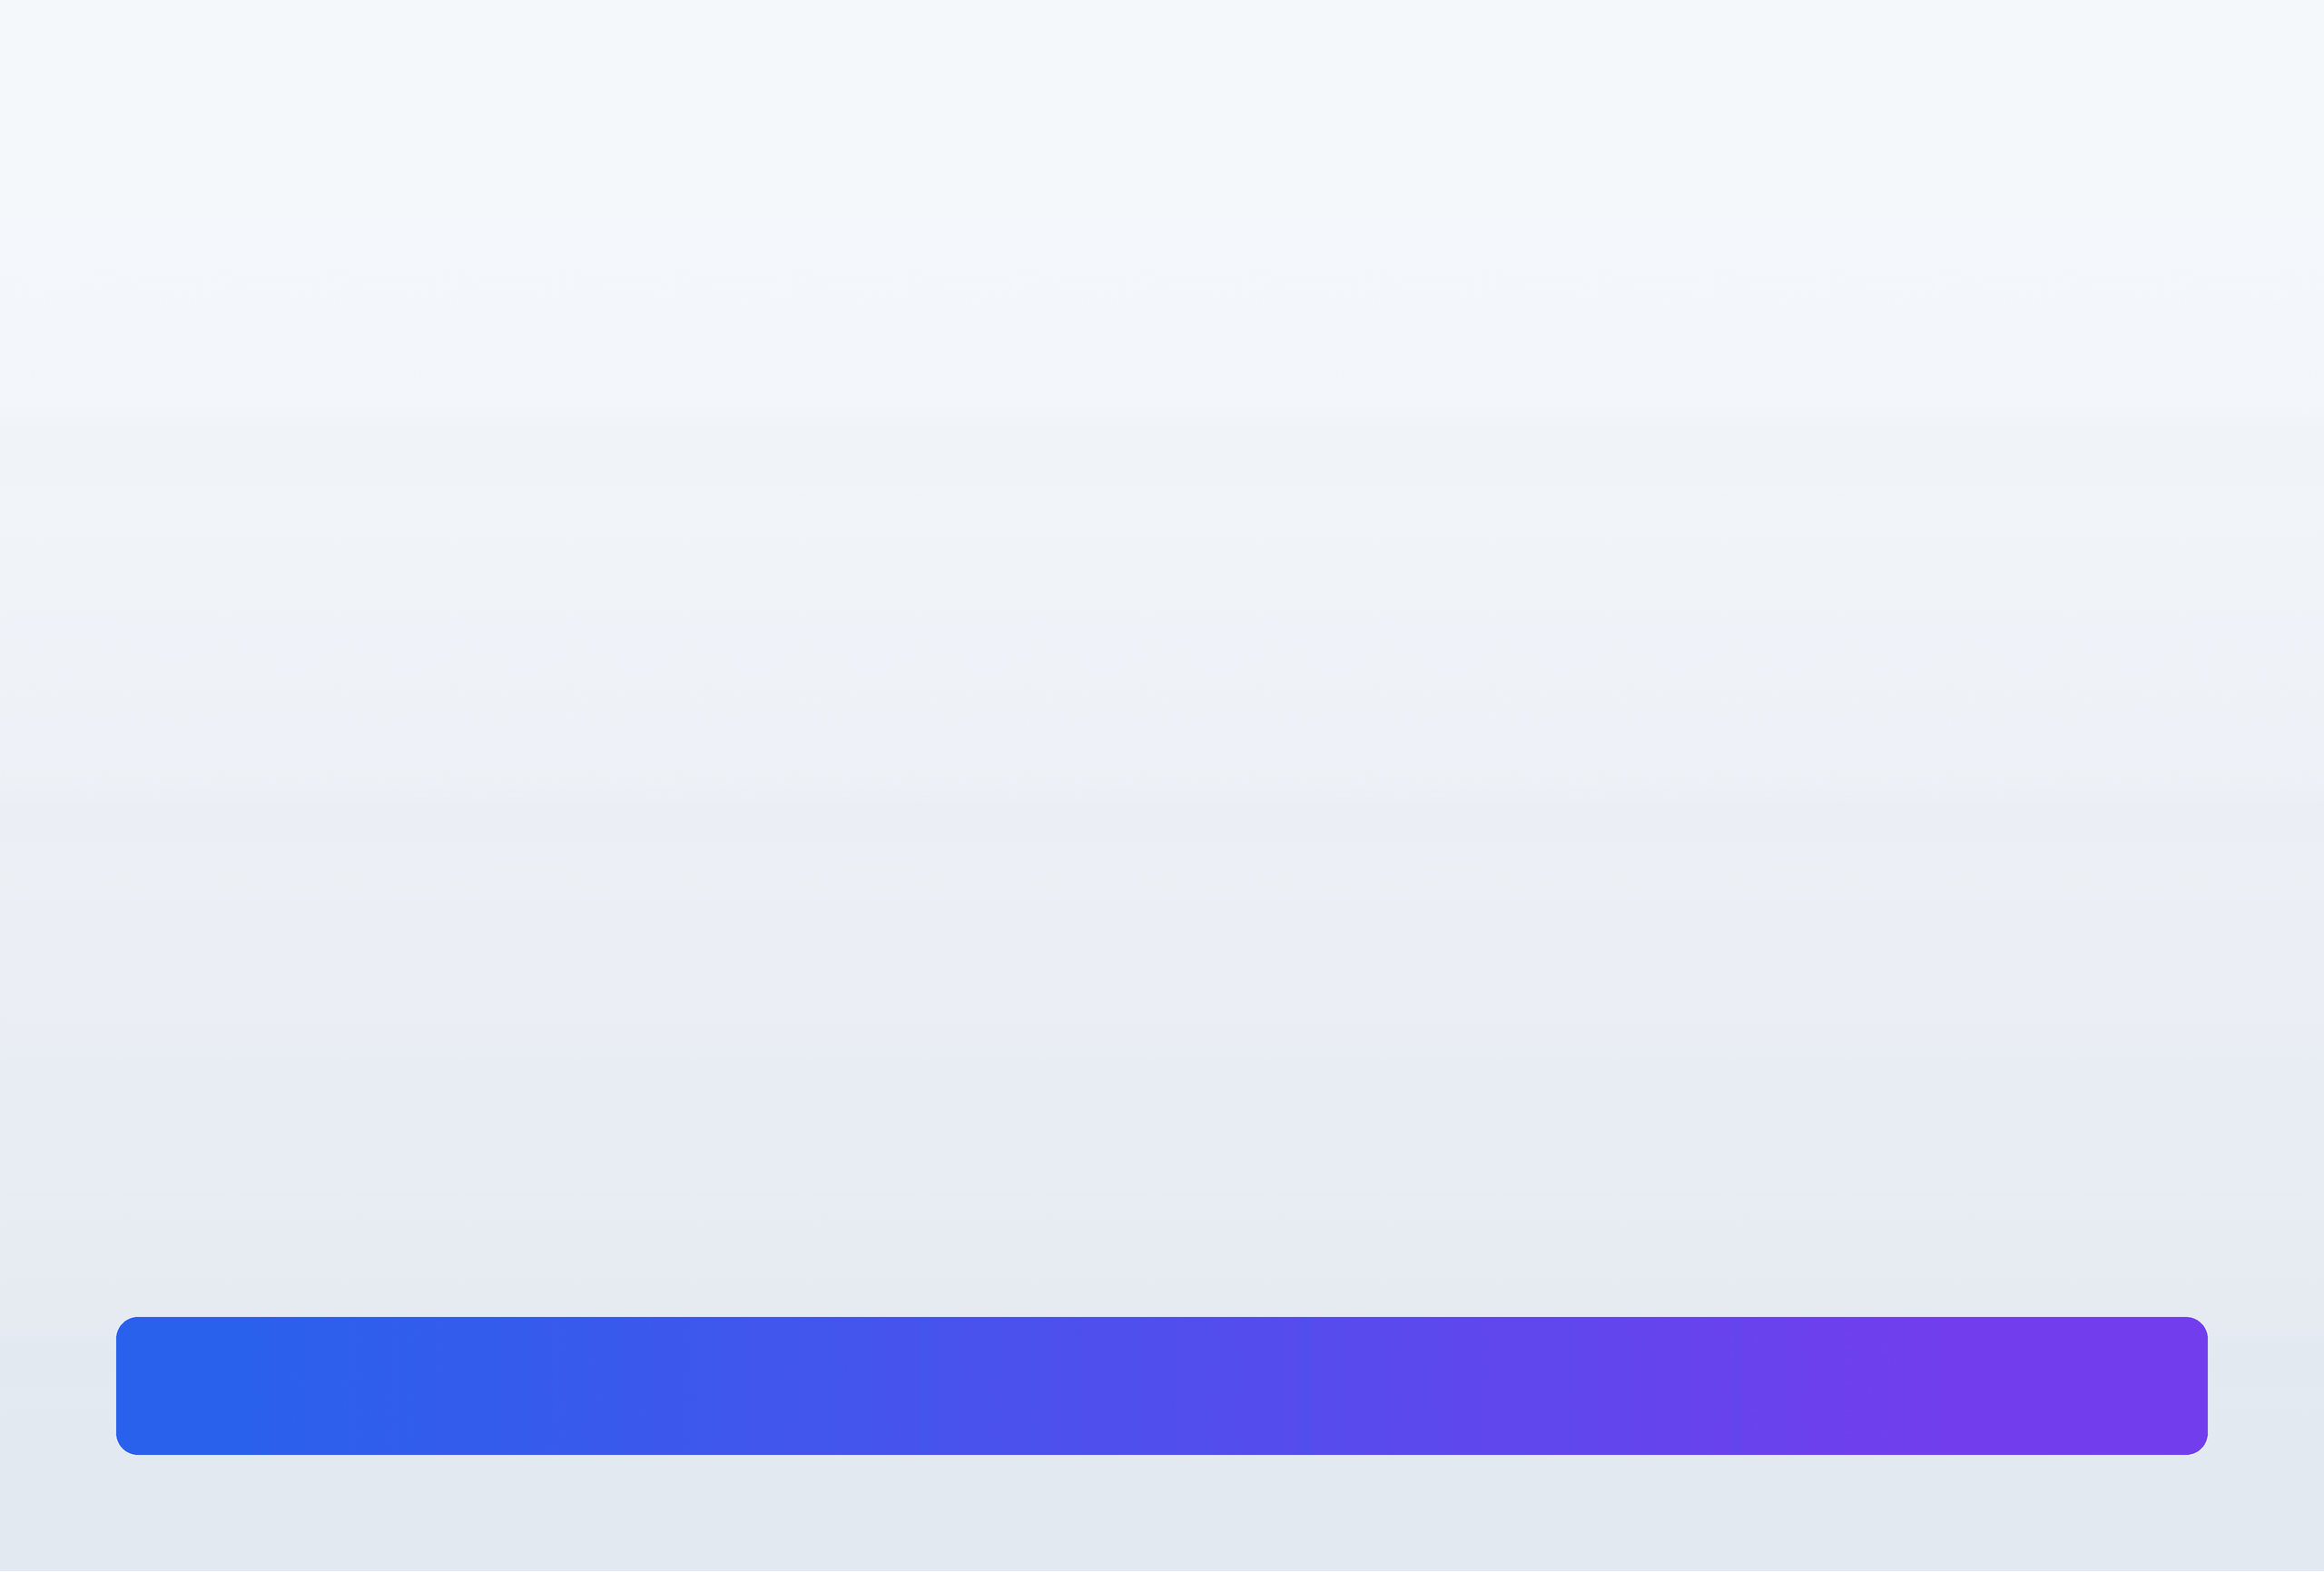









Why is ISO 27001 Important?
Legal Compliance
Competitive Advantage
Meet increasing legal requirements and regulations like GDPR and NIS 2 with a structured approach
Stand out from competitors by demonstrating commitment to information security
GDPR Ready
Certified Trust
Lower Costs
Better Organization
Prevent security incidents before they happen, saving significant costs
Define clear processes and procedures, reducing confusion and maintaining knowledge
Prevention Focus
Structured Processes
Investment in ISO 27001 is far smaller than the cost savings you'll achieve

Slide 4







The Three Principles of ISO 27001
The CIA Triad - Foundation of Information Security
Confidentiality
Integrity
Availability
Only authorized persons have the right to access information
Only authorized persons can change the information
Information must be accessible to authorized persons whenever needed
Controlled Modifications
Authorized Access Only
Always Accessible
The CIA Triad Balance
Effective information security requires balancing all three principles to protect your organization's valuable data assets

Slide 5







How Does ISO 27001 Work?
Risk Management Approach
Core Philosophy
Protect information by systematically identifying and managing risks
1. Risk Assessment
2. Risk Treatment
3. Documentation
Identify potential incidents that could happen to your information
Define security controls to prevent incidents from happening
Create Statement of Applicability listing all implemented controls
Find the Risks
Implement Controls
Document Everything
Systematic approach to treat risks through security controls and safeguards

Slide 6






ISO 27001 Controls (Annex A)
93 Security Controls in 2022 Revision
Organizational Controls
People Controls
Section A.5
Section A.6
Rules and expected behavior from users, equipment, software, and systems
Knowledge, education, skills, and experience for secure activities
Access Control Policy
Security Awareness Training
BYOD Policy
Internal Auditor Training
Physical Controls
Technological Controls
Section A.7
Section A.8
Equipment and devices with physical interaction with people and objects
Software, hardware, and firmware components in information systems
CCTV Cameras
Backup Systems
Alarm Systems
Antivirus Software
Controls reduce risks to acceptable levels through systematic implementation

Slide 7




Structure of ISO 27001 Standard
Two-Part Framework
Part 1: Main Standard
Part 2: Annex A
Clauses 0-3: Introduction
Control Guidelines
• Introduction
93 control objectives and controls organized into 4 sections
• Scope
• A.5: Organizational controls
• Normative references
• A.6: People controls
• Terms and definitions
• A.7: Physical controls
• A.8: Technological controls
Clauses 4-10: Mandatory Requirements
• Context of the organization
Risk-Based Selection
• Leadership
Controls are selected based on risk assessment and treatment process, not all are mandatory
• Planning
• Support
• Operation
• Performance evaluation
SELECTIVE Implementation
• Improvement
MANDATORY for Compliance
Both parts work together to provide a complete framework for information security management

Slide 8










Key Requirements for Compliance
Essential Elements for ISO 27001
Documented Information
Required Activities
PDCA Cycle
Policies
Risk Assessment
Plan
Plans
Risk Treatment
Do
Records
Internal Audit
Check
Procedures
Management Review
Act
Continual Improvement Process
PLAN
DO
CHECK
ACT
Establish ISMS
Implement ISMS
Monitor ISMS
Improve ISMS

Slide 9



Implementation & Certification Process
Your Journey to ISO 27001 Certification
1
2
3
Define ISMS Scope
Conduct Risk Assessment
Implement Controls
Determine boundaries and applicability of your information security management system
Identify, analyze, and evaluate information security risks
Deploy selected security controls and create Statement of Applicability
4
5
6
Internal Audit
Management Review
Certification Audit
Conduct internal audits to verify ISMS effectiveness
Senior management reviews ISMS performance and effectiveness
External certification body conducts formal audit for certification
Typical Timeline: 6-12 months
Certificate Valid: 3 years

Slide 10








Questions & Discussion
Let's explore ISO 27001 together
Questions & Answers
Further Resources
What challenges do you face with information security?
ISO Official Website
iso.org/standard/27001
How can ISO 27001 benefit your organization?
Advisera Academy
Training and Templates
What's your next step toward implementation?
IT Governance
Implementation Guidance
Professional Communities
ISACA, (ISC)², ISO Forums
Thank you for your attention!
Start your ISO 27001 journey today

